Slide 1
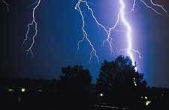
Weather Patterns
Data Analytics and Visualization Final Project
John Bates | Brittany Woolard | Danielle Duce | Lakenia Manago

Slide 2
Purpose
Analyze weather patterns among the east coast
Predict the likelihood of bad weather
Determine factors contributing to storm strikes in Florida
Provide analysis for meteorologists

Slide 3
Data Exploration Phase
Questions we want to answer
What factors contribute to storm strikes in Florida?
What weather patterns do we observe with our data?
Finding the best data that fits our needs
How do we filter our data to suit our analysis?
What database structure can we use to present our findings?
What are the optimal tools to present our data?

Slide 4
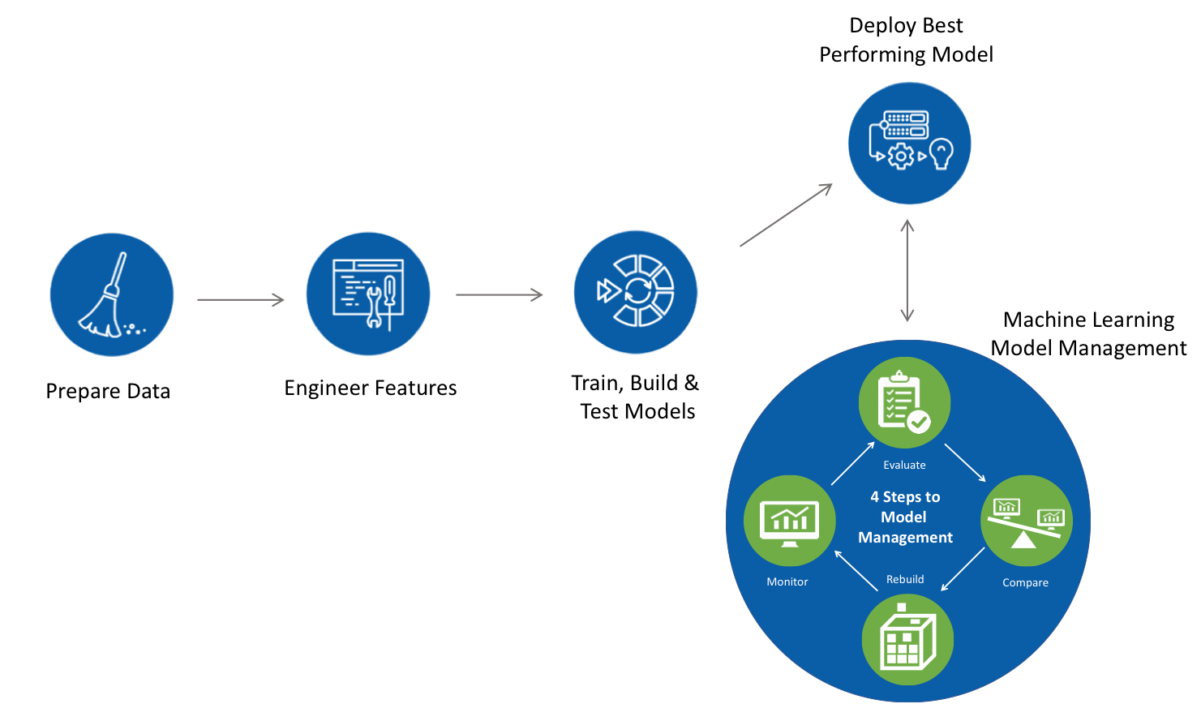
Machine Learning Pipeline

Slide 5
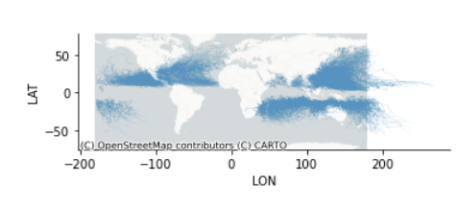
Data Preprocessing
Data Sources:
Storm Events DB from NOAA.gov (CSV file)
Geojson of US states from GitHub
Preprocessing steps:
Data files are imported to Pandas dataframes
Unnamed storms are dropped from dataframe.
Data is mapped in Pandas to view data points.

Slide 6

Data Preprocessing
Preprocessing steps (cont.):
Geohash columns are created for latitude and longitude coordinates.
Geohash encodes a geographic location into a string of letters and digits.
The length of the geohash determines the area covered by the geohash.
In our analysis we are using the following geohash lengths.
Geohash Level | CellWidth | Cell Height
2 | 1,250 km | 625 km
5 | 4.89 km | 4.89 km

Slide 7
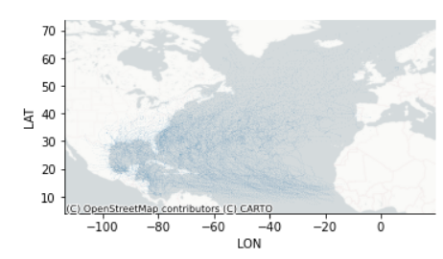
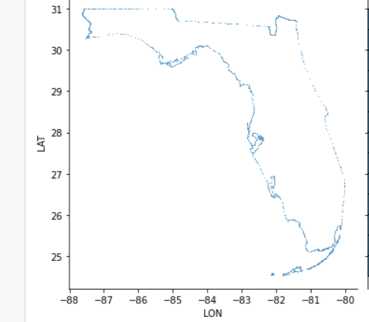
Data Preprocessing
Preprocessing steps (cont.):
Dataframe is filtered to the North Atlantic region.
Florida geojson file is imported to Pandas.
Florida geohash values are calculated.
Dataframes are exported to Postgres for DB processing.

Slide 8
Database Structure
Entity Relationship Diagram

Slide 9
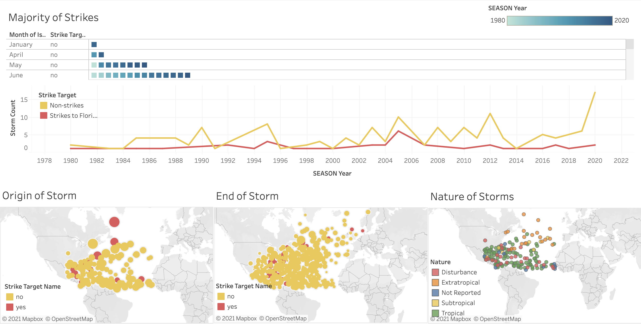
Data Analysis
Visualize the Data
Tableau Dashboard
Notes:
Storm Strike Dashboard Link

Slide 10
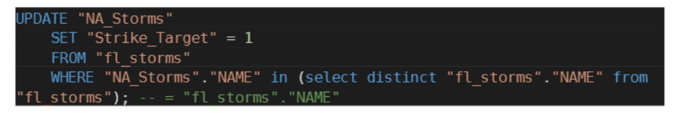
Data Analysis
Strike Target
Notes:
Set value of “Strike_Target” to 1 if exists in “fl_storms” table. Note, a 1 in the
Strike_Target column indicates a storm strike in the target area

Slide 11

Data Analysis
Logistic Regression Model
Notes:
Based on the Logistic Regression Learning Model we have an accuracy score of 70%. For this machine learning model we used sklearn.preprocessing.

Slide 12
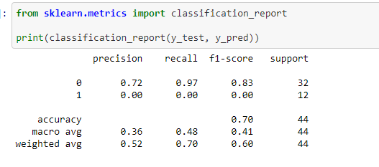
Data Analysis
Cont’d Logistic Regression Model
Notes:
Based on the Logistic Regression Learning Model we have an accuracy score of 70%. For this machine learning model we used sklearn.metric.

Slide 13
Tools Used
Preprocessing
Pandas, Numpy, CSV
Matplotlib, Geopandas
Seaborn, Contextily
Pygeohash, Polygeohasher
Creating Database
PostgresSQL
Connecting to Database
SQLAlchemy, Psycopg2 module
Machine Learning
Sklearn.preprocessing
sklearn.metric
Dashboard
Tableau

Slide 14
Recommendations for Future Analysis
Explore other features for correlation
Make other analysis based on the severity of the storm

